Slide 2
Deep dive into background tasks in the Universal Windows Platform
Matteo Pagani
Windows AppConsult Engineer @ Microsoft
matteo.pagani@microsoft.com
Twitter: @qmatteoq

Slide 3
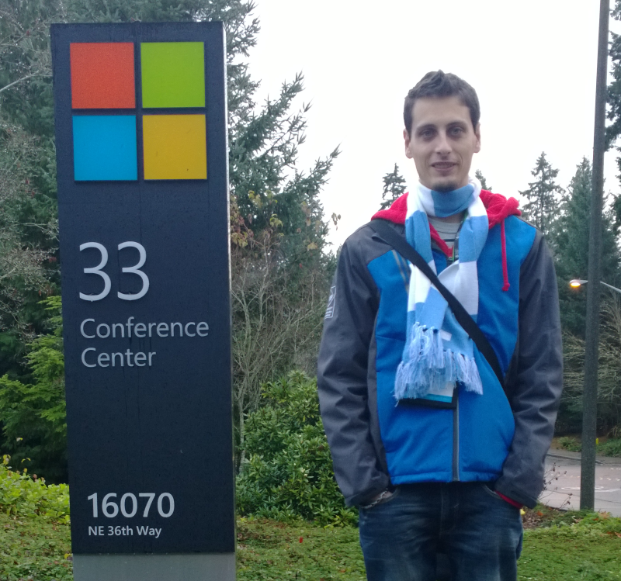
Matteo Pagani
Former Microsoft MVP – Windows Platform Development for 5 years
Former Nokia Developer Champion
Author of many books about Windows development
Windows AppConsult Engineer in Microsoft

Slide 5
Agenda
A quick recap of the app’s lifecycle
Extended execution
Background tasks
New Windows 10 scenarios:
App services
Cortana
Interactive notifications

Slide 6
The application’s lifecycle

Slide 7
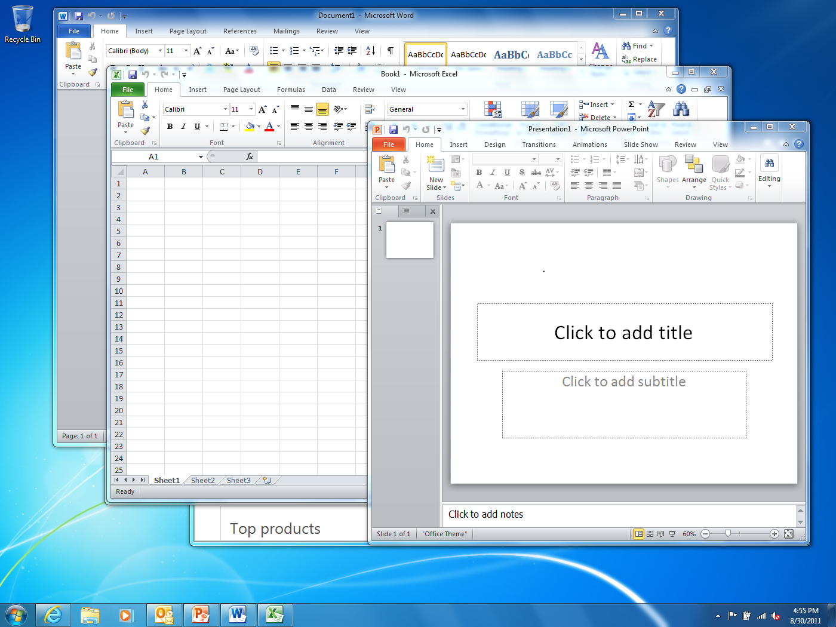
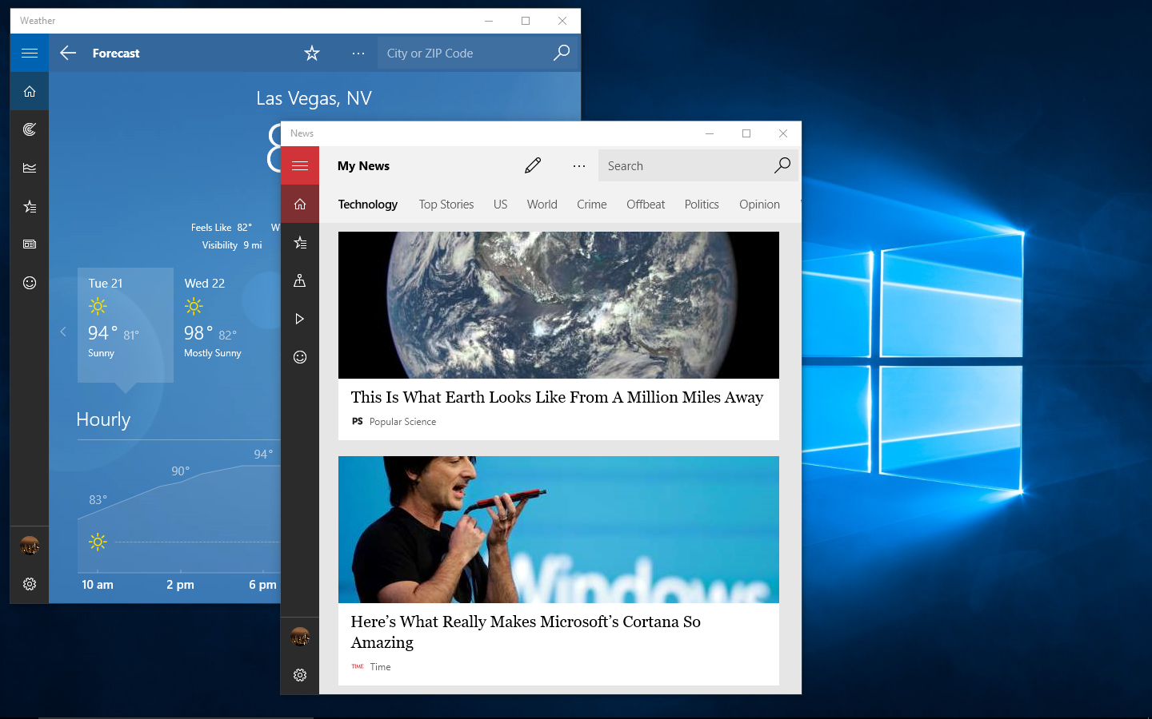
When do Apps Run?
Windows Desktop app User manages app lifetime
Universal Windows Apps: System also manages app lifetime
Notes:
As a developer, you have to know how Windows manages your app lifetime and how to be a good citizen.
[EDITOR] Vinod.K:
Friday, December 06, 2013 WSA needs to be expanded.
Also, “and how to be a good citizen” seems somewhat out of context here. Is it relevant?

Slide 8
Process Lifetime Walkthrough
Running
App 1
App 2
App 3
…
App N
Apps suspend after a short delay
Apps resume instantly from suspend
Suspended
App terminated under memory pressure without notification
Not Running
Notes:
Apps gets a minimum of 5 seconds to handle suspension (save state etc.) Potentially a little more if there is I/O contention
You will see that apps get into the suspended state after about 10 seconds.
You can check it if you launch another App and keep the Task Manager at the same time on the screen
Suspended Apps are notified before being suspended
After that event, no more CPU for the application threads
If you take too long to suspend… you’ll get terminated
Windows is free to “terminate” any WSA if memory pressure is detected
Apps are not notified before being terminated
See http://msdn.microsoft.com/en-us/library/windows/desktop/aa366541(v=vs.85).aspx for API to use to detect when memory is running high/low but it is for desktop apps only
NOTE: in Windows 10, the system takes care of trimming the working set when an App gets suspending and so reduces heavily the need to terminate an App
See http://blogs.msdn.com/b/b8/archive/2012/04/17/reclaiming-memory-from-metro-style-apps.aspx for details about memory management based on Working Set metrics in Windows – may be outdated
For more information about API to use to detect when memory is running high/low, see: http://msdn.microsoft.com/en-us/library/windows/desktop/aa366541(v=vs.85).aspx.
For more information about memory management based on Working Set metrics in Windows, see:
http://blogs.msdn.com/b/b8/archive/2012/04/17/reclaiming-memory-from-metro-style-apps.aspx.

Slide 9
Suspend
System resources are focused on the app that the user is interacting with in the foreground
Suspended apps have no impact on battery life or responsiveness of the active app
Enables instant switching between apps!
Store apps minimized on the desktop are suspended
Notes:
= “tombstoning” in Windows phone (read http://msdn.microsoft.com/en-us/library/ff817008(v=vs.92).aspx for the execution model in WP)
This also visible with SysInternals Process Explorer (http://technet.microsoft.com/en-us/sysinternals/bb896653.aspx) where you see the same “Suspended” in the CPU column. It was possible to “suspend” a process in Windows 7 with Process Explorer: this is now done by Windows itself for WSAs.
NOTE: Process Explorer is fully aware of WSAs = “Immersive” has new blue color. See Options | Configure Colors | Immersive Process + see package in tooltip
When you right-click | Resume on a Suspended Metro App, it gets back automatically Suspending immediately by Windows
For more information about the execution model in WP, see: http://msdn.microsoft.com/en-us/library/ff817008(v=vs.92).aspx.
[EDITOR] Vinod.K:
Friday, December 06, 2013 Please confirm if it should be “where you see the same Suspended status”.
Note: Process Explorer is fully aware of WSAs = Immersive has new blue color. See Options > Configure Colors > Immersive Process and see the package in tooltip. When you right-click Resume on a Suspended Metro App, it gets back automatically suspending immediately by Windows.
[EDITOR] Vinod.K:
Friday, December 06, 2013 Please validate the usage of "Metro" against the LCA guidelines.
[EDITOR] Vinod.K:
Friday, December 06, 2013 This content needs to be rephrased for better understanding.
[EDITOR] Vinod.K:
Friday, December 06, 2013 Please confirm if “Tombstoning ” is appropriate here. Kindly provide an alternate term.

Slide 10
Suspend Under the Hood
Suspended apps are not scheduled by the NT Kernel
No CPU, disk, or network consumed
All threads are suspended
Apps remain in memory
Apps instantly resumed from suspend when brought back to foreground

Slide 11
Termination
User explicitly closes the app (suspended first!)
System needs more memory
User switch occurs
User logoff/System shutdown
App crash
Apps do not get notified when they are getting terminated
Notes:
The user can still decide to explicitly “close”/”end” an App by using ALT+F4, the drag/drop touch gesture (“drag the top of the App and drag it down to the bottom of the screen”) suspends the app. (although it is removed from the ALT-TAB backstack). In 8.1, if the user drop the app and wait a few seconds, the thumbnail flips and shows the logo → this is a real termination. Otherwise, the app is just suspended (but removed from the app list)
On desktop, you have windows apps that you can just kill by clicking the corner x
The system is also allowed to “terminate” the apps.. [users can do it too via task manager or Process Explorer]. Note that if the user right-clicks on a thumbnail of the App list and choose “Close”, the app is removed from the list and only suspended, not closed
DEMO: use ByeBye tool from http://iinspectable.wordpress.com/2012/07/08/forcing-metro-apps-to-terminate to consume as much memory (working set) as possible and see that first the Immersive App working set are trimmed and then some Apps get terminated → it might not work for Win10 on a PC for Apps such as Calendar, News or Weather even when another byebye.exe is started to reclaim more memory: Windows 10 is trimming the working set of a suspended App so the memory consumption drops, avoiding the need to terminate the suspended Apps. However, it should be more easily seen on low memory devices (phone, IoT…)
Watch http://channel9.msdn.com/Events/TechEd/NorthAmerica/2011/WCL405 for Mark Russinovich talk about Windows memory management
Watch http://channel9.msdn.com/Events/TechEd/NorthAmerica/2011/WCL405 for Mark Russinovich talk about Windows memory management.

Slide 12
Register for Suspend and Resume
// Register for the Suspending event and call OnSuspending when received
App.Current.Suspending += OnSuspending;
// Handle the suspending event and save the current user session using WinJS sessionState
void async OnSuspending(object sender, Windows.ApplicationModel.SuspendingEventArgs e)
{
var deferral = e.SuspendingOperation.GetDeferral();
//TODO: Save application state and stop any background activity
deferral.Complete();
}
// Register for the Resuming event and call OnResuming when received
App.Current.Resuming += OnResuming;
void OnResuming( object sender, object e)
{
{ // We are getting resumed, in general do nothing
}}
Notes:
Suspending:
You have 5 seconds real time (not CPU time) to save what you need to save. If you take too long, the App will be terminated.
Deferral here means telling the OS you are doing some async tasks; not that you want to get more than 5 sec time. Note the async keyword to indicate we’re going to call awaitable I/O functions.
In 8.1 Suspending happens with low priority (low I/O, lower thread priority) Suspend time compensates for this.
Resuming:
Sometimes useful for checking for updates in case of a News, weather, stocks App for example.
Ex: you’ve stored the time of suspension and, on resuming, if there are more than x hours since then, the code checks for News updates.
NOTE: when the App gets suspended, all the event handlers are still registered (sockets, system related,…) but will never get any CPU to run even if such an event occurs. So on resume you need to check your network, sockets, etc.
Note: When the app gets suspended, all the event handlers are still registered (sockets, system related) but will never get any CPU to run even if such an event occurs. So on resume you need to check your network, sockets, etc.

Slide 13
Handle termination
protected override void OnLaunched(LaunchActivatedEventArgs e)
{
Frame rootFrame = Window.Current.Content as Frame;
// Do not repeat app initialization when the Window already has content,
// just ensure that the window is active
if (rootFrame == null)
{
// Create a Frame to act as the navigation context and navigate to the first page
rootFrame = new Frame();
rootFrame.NavigationFailed += OnNavigationFailed;
if (e.PreviousExecutionState == ApplicationExecutionState.Terminated)
{
//TODO: Load state from previously suspended application
}
// Place the frame in the current Window
Window.Current.Content = rootFrame;
}
}
Notes:
Suspending:
You have 5 seconds real time (not CPU time) to save what you need to save. If you take too long, the App will be terminated.
Deferral here means telling the OS you are doing some async tasks; not that you want to get more than 5 sec time. Note the async keyword to indicate we’re going to call awaitable I/O functions.
In 8.1 Suspending happens with low priority (low I/O, lower thread priority) Suspend time compensates for this.
Resuming:
Sometimes useful for checking for updates in case of a News, weather, stocks App for example.
Ex: you’ve stored the time of suspension and, on resuming, if there are more than x hours since then, the code checks for News updates.
NOTE: when the App gets suspended, all the event handlers are still registered (sockets, system related,…) but will never get any CPU to run even if such an event occurs. So on resume you need to check your network, sockets, etc.
Note: When the app gets suspended, all the event handlers are still registered (sockets, system related) but will never get any CPU to run even if such an event occurs. So on resume you need to check your network, sockets, etc.

Slide 14
Best Practices for Saving/Restoring State
Scenario | You should:
User is using your app | Save user data incrementally
App switched away from (Suspending) | Save where the user is – what screen they are on, for example
Not running app launched by user (Activated) | Bring the user back and restore their session as if they never left
Suspended app activated by user (Resuming) | App specific
Notes:
Third row is key point of the slide. The whole reason we save during suspend is so that we can come back to that state on relaunch (not resume).
On Resume an app can check if its data is stale. E.g. a news app that has not been used for 2 weeks, might want to update is front page.
→ Explain that Windows does not provide this time but need to be computed by saving the time of suspension (see http://blogs.msdn.com/b/mspfe/archive/2013/06/17/suspend-and-resume-in-winrt.aspx for more details)
[EDITOR] Vinod.K:
Friday, December 06, 2013 This content lacks clarity. Please update for better understanding.
For more information, see: http://blogs.msdn.com/b/mspfe/archive/2013/06/17/suspend-and-resume-in-winrt.aspx.

Slide 15
What if I need more time?

Slide 16
Extended Execution
Continue a session when not in the foreground
Location Tracking
Save critical data
You just want more time
Notes:
These are examples of needs for extended execution

Slide 17
Extended Execution details
Applications must supply a reason
Revoked events will have ~1 sec to clean up
Min time is guaranteed but opportunistic afterwards
Notes:
Min time depends on the resources on the system; bigger systems get more time: sometimes even never suspended
2 extended execution:
At Suspending event time → I need more time than the 5s
At foreground time → I need to ALWAYS run (I won’t get the Suspending event but just the Revoked first and then the Suspending just before being terminated)

Slide 18
Extended Execution (1. wait!)
Running
Extend
Suspended
Request
Revoked (1 second)
Memory
No UI
(short)
When
suspending
Suspended (5 seconds)
Suspended
(No event)
Notes:
At Suspending event time → I need more time than the 5s

Slide 19
Extended Execution (2. let me run)
Running
Extend
Suspended
Automatic extension
Revoked (1 second)
Memory
No UI
(long running)
When
running
Special Request (during runtime)
Navigate away
Suspended
(No event)
Notes:
At foreground time → I need to ALWAYS run (I won’t get the Suspending event but just the Revoked first and then the Suspending just before being terminated)

Slide 20
Demo Extended Execution

Slide 21
Background tasks

Slide 22
The App Lifecycle with Background Tasks
Background
Task Executes
Background
Task Executes
Background
Task Executes
Running
App
Suspended
App
Terminated
App
Suspending
Low Memory
Resuming
Notes:
If the previous APIs are not enough, you can define background tasks to run even when you are is not
→ Green boxes code runs in parallel to the App or while suspended/terminated
Read http://blogs.msdn.com/b/windowsappdev/archive/2012/05/24/being-productive-in-the-background-background-tasks.aspx for more details
Note: They are not supposed to communicate with each other, but it is possible either by Progress/Completed/Canceled events or by file.
For more information, see: http://blogs.msdn.com/b/windowsappdev/archive/2012/05/24/being-productive-in-the-background-background-tasks.aspx.

Slide 23
Registration and Firing
Register task for Trigger
Re
Yourapp.exe
BackgroundTaskHost.exe
Windows
MyBackgroundTask
(Windows Runtime Component)
Create
Call Run()
Notes:
Animated Slide to describe the different steps of having a background task to run
Your app registers trigger with windows
App can be suspended (fade to 50% transparent)
App can be terminated (app block disappears)
Trigger (lightning) fires
Windows creates the process
Loads up the Windows Runtime component
Calls Run()
Background process is torn down

Slide 24
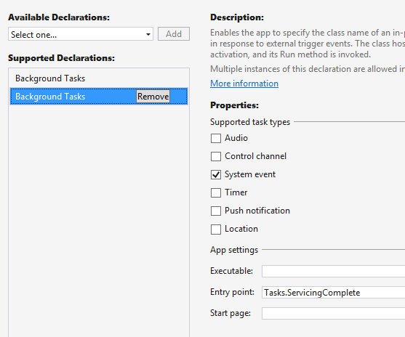
System Trigger in Manifest
Multiple per app
System Trigger
Leaving blank: BackgroundTaskHost.exe
Windows Runtime Component
Notes:
TODO: check if the VS 2015 RTM comes with a GUI manifest editor or… raw XML
Triggers is the way to tell Windows when to start the background task
Demo (previous slide)
Requirements for non-lock screen app triggers (such as system).
You might have to show this in AppXManifest. Note the Entrypoint is the Class name.

Slide 25
Triggers
SystemTrigger
TimeTrigger
MaintenanceTrigger
DeviceUseTrigger
DeviceServicingTrigger
PushNotificationTrigger
CachedFileUpdaterTrigger
DeviceConnectionChangeTrigger
GattCharacteristicNotificationTrigger
RfcommConnectionTrigger
LocationTrigger
AppointmentStoreNotificationTrigger
ContactStoreNotificationTrigger
EmailStoreNotificationTrigger
BluetoothLEAdvertisementWatcherTrigger
BluetoothLEAdvertisementPublisherTrigger
DeviceWatcherTrigger
ActivitySensorTrigger
SensorDataThresholdTrigger
ToastNotificationHistoryChangedTrigger
ToastNotificationActionTrigger
ApplicationTrigger
MediaProcessingTrigger
SocketActivityTrigger
Windows 8.1
Windows 10
WP 8.1
Notes:
Application Trigger
Or how to directly call a background task from an App
Triggered from the foreground application
Useful for initial syncing of data
Socket trigger
Apps can have network connectivity and discoverability maintained
Even when suspended or terminated.
Successor of control channel trigger
Alternative to WNS triggered Tasks
How it works:
In foreground app process:
Create/retrieve socket(s)
Register background task to be woken up
Give socket to broker service as app is suspending
Take socket back from broker service at any time
On incoming network activity on brokered socket:
Background task is triggered
Take socket back from broker service

Slide 26
System Conditions
Condition latches trigger
Prevents trigger from firing, if it cannot function anyway
System Condition | Description
InternetAvailable/InternetNotAvailable | Availability of Internet connectivity
UserPresent/UserNotPresent | Presence of user
SessionConnected/SessionDisconnected | User’s logged-on status
FreeNetworkAvailable | Availability of free internet
BackgroundWorkCostNotHigh | Only when on AC

Slide 27
Communication between App and Task
Progress, Completion, Cancellation events
Yourapp.exe
BackgroundTaskHost.exe
Windows
MyBackgroundTask
(Windows Runtime Component)
Completed
Progress
Cancel
Cancel
Notes:
It is possible for a running app to follow the execution of a background task by listening to specific events

Slide 28
Demo A simple background task

Slide 29
Resource Management
Opportunistic Background Tasks
Run for as long as resources are available
No guarantee of execution
ApplicationTrigger, MaintenanceTrigger, DeviceUseTrigger
Default Background Tasks
Guaranteed minimum execution time of 25 secs
Everything else: TimeTrigger, PushTrigger…
Example 512MB Mobile device
Memory
Task type | Memory Cap MB | Lifetime | CPU | Block in Batt-Sav
Default Background Task | 16 | 30 sec | 10% | Y
Long-Running | 16 | ∞ | 10% | Y
Run
Cancel
Run
Notes:
CPU is minimum of 10%
Memory goes up with larger systems.
watch https://channel9.msdn.com/Events/Build/2015/3-626 for the details

Slide 30
Background task best practices
Design background tasks to be short lived
Use persistent storage via ApplicationData to share data between the background task and the app
Ensure that the background task class library is referenced in the main project and its output type is winmd
Do not display UI other than toast, tiles or badges from a background task. (Do not rely on user interaction in background tasks)
Notes:
We removed the following guidance
Use BackgroundTaskHost.exe as the executable for background tasks
3-626 explicitly mentions you can do this.
Use persistent storage via ApplicationData to share data between the background task and the app
You can use applicationtrigger or app services.
[EDITOR] Vinod.K:
Friday, December 06, 2013 Please confirm if “Microsoft Surface” and needs to be added to EULA as well in the PPT.
[EDITOR] Vinod.K:
Friday, December 06, 2013 This content needs to be rephrased for better readability.

Slide 31
App services A special kind of background tasks

Slide 32
Building a Web of Apps
Allow apps to integrate using the best of the web
URL based activation/communication
Foreground to Foreground
Very similar to the web model
Allows for custom scheme invocation skype:andrewclinick
New in 10 - the ability to return results, query for apps and enumerate apps
Foreground to Background
Application services
Enables you to “publish” a background task that can be called by other apps
Facebook & Twitter integration with the People app is a key example of this
Notes:
Allow apps to integrate using the best of the web
URL based activation/communication – between apps
(read https://iinspectable.wordpress.com/2013/06/04/inter-process-silent-communication-in-winrt-part-4/ for more about 8.1 way of doing things → each App had to implement a custom protocol)
Foreground to Foreground
Very similar to the web model
Allows for custom scheme invocation skype:andrewclinick
If you want to make a call, just click it and Skype will launch and you’re moving foreground to foreground between applications
Facebook SDK for Auth
Could launch a URL, to get a result back, involved shared secrets – not the best way
New in 10 - the ability to return results, query for apps and enumerate apps
Call an application and get a result back
Running in a window, applications called are bound to your window
Foreground to Background
Application services
Enables you to “publish” a background task that can be called by other apps
Allows you to call an application, but your app stays in the foreground
Facebook & Twitter integration with the People app is a key example of this
People app calls background tasks to Facebook, without switching to Facebook
Prevents you from losing a user to another app just because you switched
NOTE: Microsoft is heavily using its own technology for Win10
Cortana and People app use app services extensively
People
Social Network Extensibility
Cortana
Voice Commands on Cortana’s canvas
Office & Skype
Skype: & Lync: for meeting requests
Interactive Toasts
You can reply in-line

Slide 33
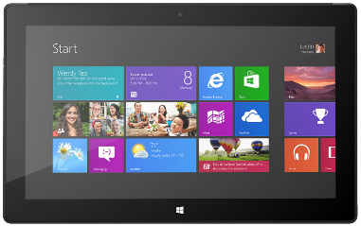
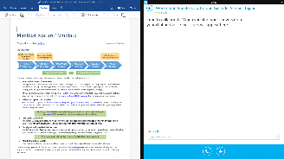
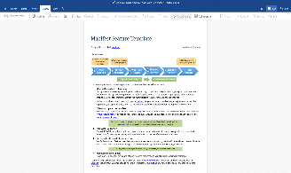
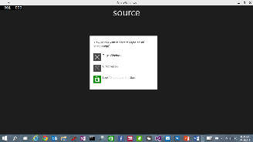
App to App in Windows 10
1. Launch a “specific” apps
2. send data, send file token
3. Launch for result
4. App Services

Notes:
You can now launch specific apps
Send data or send files using Launcher.LaunchUriAsync/Launcher.LaunchFileAsync
Send a request and expect a result
Like web service → call another app background task (I won’t spend to much time)
NOTE: it is also possible to defined a folder shared between Apps from the same publisher

Slide 34
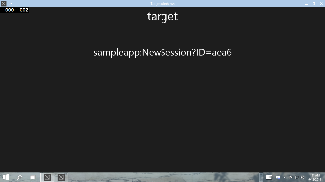

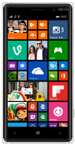


App Service = ‘Web Services on device’
Client App A
App with App Service
Background Task
Client App B

Slide 35
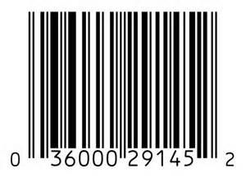
Scenario: Bar Code Scanning
Bar Code decoding App Service
Image bytes in ValueSet or FileToken
Decoded data
Notes:
Simple scenario where the background task compute a result based on input

Slide 36
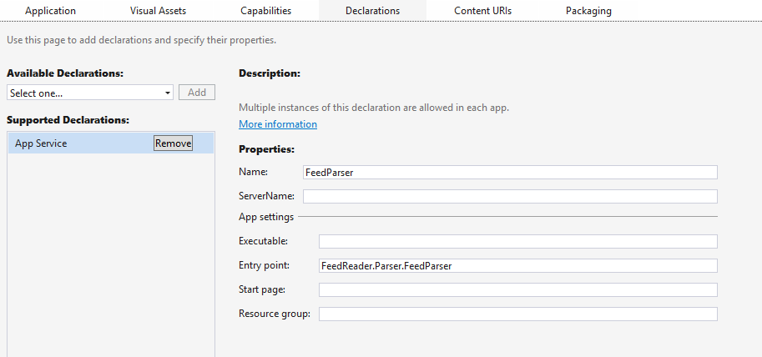
Register an App Service
There’s a specific declaration in the manifest
You have to set the name and the entry point
You don’t have to register in code like a background task
Notes:
Allow apps to integrate using the best of the web
URL based activation/communication – between apps
(read https://iinspectable.wordpress.com/2013/06/04/inter-process-silent-communication-in-winrt-part-4/ for more about 8.1 way of doing things → each App had to implement a custom protocol)
Foreground to Foreground
Very similar to the web model
Allows for custom scheme invocation skype:andrewclinick
If you want to make a call, just click it and Skype will launch and you’re moving foreground to foreground between applications
Facebook SDK for Auth
Could launch a URL, to get a result back, involved shared secrets – not the best way
New in 10 - the ability to return results, query for apps and enumerate apps
Call an application and get a result back
Running in a window, applications called are bound to your window
Foreground to Background
Application services
Enables you to “publish” a background task that can be called by other apps
Allows you to call an application, but your app stays in the foreground
Facebook & Twitter integration with the People app is a key example of this
People app calls background tasks to Facebook, without switching to Facebook
Prevents you from losing a user to another app just because you switched
NOTE: Microsoft is heavily using its own technology for Win10
Cortana and People app use app services extensively
People
Social Network Extensibility
Cortana
Voice Commands on Cortana’s canvas
Office & Skype
Skype: & Lync: for meeting requests
Interactive Toasts
You can reply in-line

Slide 37
Calling an App Service
Package with App Service
var conn = new AppServiceConnection();
conn.AppServiceName = “FooAppService”;
conn.PackageFamilyName = “12Me.MyApp“;
var status = await conn.OpenAsync();
Client App A
App Service
Background Task
Notes:
The way to execute code without UI – Background Tasks
App services is a package of Background tasks
App A creates App Service Connection
Gives App Service Name
Gives Package Family Name
Awaits a Connection
Becomes a 2-way channel
Send a ValueSet message
App Service responds with a confirmation or a response message
Once done, connection is closed or disposed
If two apps ask for the same background tasks at once, there is another app service background task spun up automatically
Currently used in the People App
Uses News Feeds from Facebook/Twitter installed on phone
Twitter/Facebook provides the App Service
Until now, you couldn’t write your apps to access other app services
Example: Bing Maps service
Used to use HTTP request
Instead, uses device cache to pull data in
Hardware
Band can use an app service
May provide historical

Slide 38
Getting Result from an App Service
Package with App Service
Client App A
var conn = new AppServiceConnection();
conn.AppServiceName = “FooAppService”;
conn.PackageFamilyName = “12Me.MyApp“;
var status = await conn.OpenAsync();
App Service
Background Task
var message = new ValueSet();
message.Add(“Hi”, “There”);
var r = await conn.SendMessageAsync(message);
conn.Dispose();
Notes:
The way to execute code without UI – Background Tasks
App services is a package of Background tasks
App A creates App Service Connection
Gives App Service Name
Gives Package Family Name
Awaits a Connection
Becomes a 2-way channel
Send a ValueSet message
App Service responds with a confirmation or a response message
Once done, connection is closed or disposed
If two apps ask for the same background tasks at once, there is another app service background task spun up automatically
Currently used in the People App
Uses News Feeds from Facebook/Twitter installed on phone
Twitter/Facebook provides the App Service
Until now, you couldn’t write your apps to access other app services
Example: Bing Maps service
Used to use HTTP request
Instead, uses device cache to pull data in
Hardware
Band can use an app service
May provide historical

Slide 39
Demo App Service communication

Slide 40
App Services challenges
You need to know the name of the service
You need to name the Package Family Name
You need to know the expected input / output data
The solution?
Embed the logic into a class library and share it with NuGet!
Notes:
These are examples of needs for extended execution

Slide 41
Demo App Service library

Slide 42
App services Additional scenarios

Slide 43
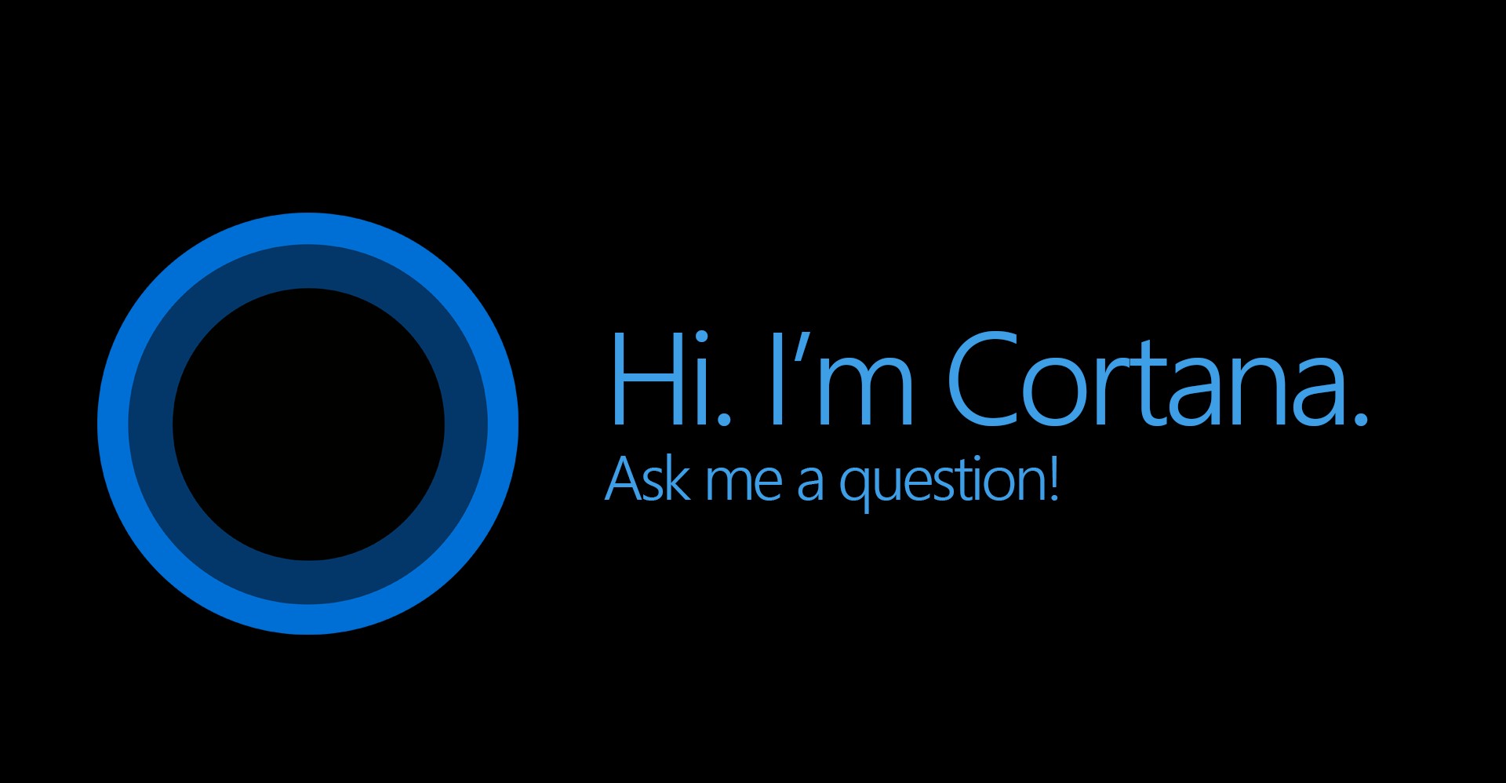

Slide 44


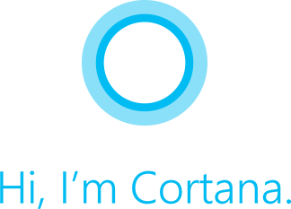
Before Windows 10
Cortana was available just as an entry point for your application
You pronounce a command (eventually) with some parameters to understand the context
The app opens and processes the command
Adventure Works, show my trip to London
Notes:
Min time depends on the resources on the system; bigger systems get more time: sometimes even never suspended
2 extended execution:
At Suspending event time → I need more time than the 5s
At foreground time → I need to ALWAYS run (I won’t get the Suspending event but just the Revoked first and then the Suspending just before being terminated)

Slide 45
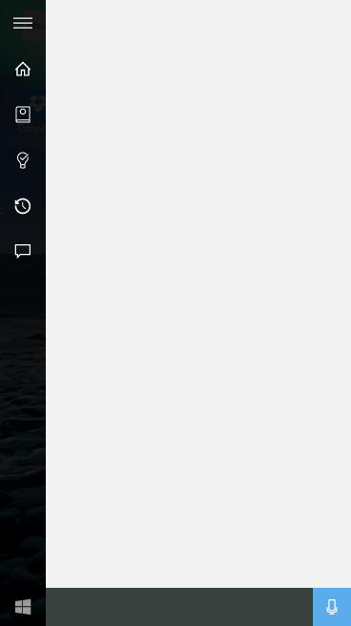
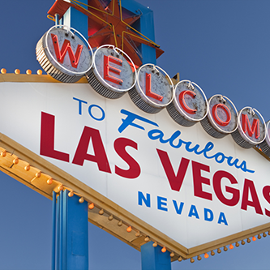


Completing tasks in Cortana
Here are your upcoming trips.
Text-To-Speech (TTS)
Introducing new capabilities that enable apps to complete tasks within Cortana.
Capabilities include:
APIs for task workflow
UI templates
Speech interactivity model
App Screen
A
App Icon
Here are your upcoming trips.
App GUI Text
Las Vegas
Content Tile
May 14th 2015
San Diego
Content Area
May 28th 2015
Phoenix
August 24th 2015
Link to your app
Go to Adventure Works

Slide 46
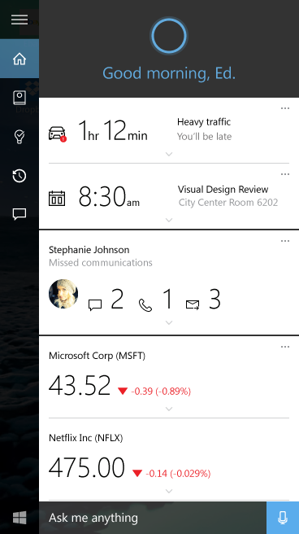


Background Voice Commands Architecture
Adventure Works, show my trip to London
Application Code
Here’s your trip to London
A
Voice Command
Background Service
Implements
Windows.
AppModel.Background.
IBackgroundTask
Here is your trip to
London
Which ‘Vegas’ trip do you wanna cancel?
9
8
App Web Service
Call
Render XAML
Text
7
8
2
Remind
Go to Adventure Works
Email
Voice Command
VCD
Isolated Storage
1
3
6
Windows Speech
Platform (on-device)
4
Microsoft Speech
Platform Service (cloud)
5

Slide 47
Demo Cortana

Slide 48

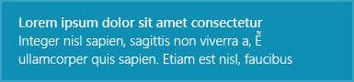
Toast notifications – Before Windows 10
Few templates available on desktop, only 1 template on mobile
No special interactions allowed
When the user taps on the notification, the app is opened
Notes:
Min time depends on the resources on the system; bigger systems get more time: sometimes even never suspended
2 extended execution:
At Suspending event time → I need more time than the 5s
At foreground time → I need to ALWAYS run (I won’t get the Suspending event but just the Revoked first and then the Suspending just before being terminated)

Slide 49
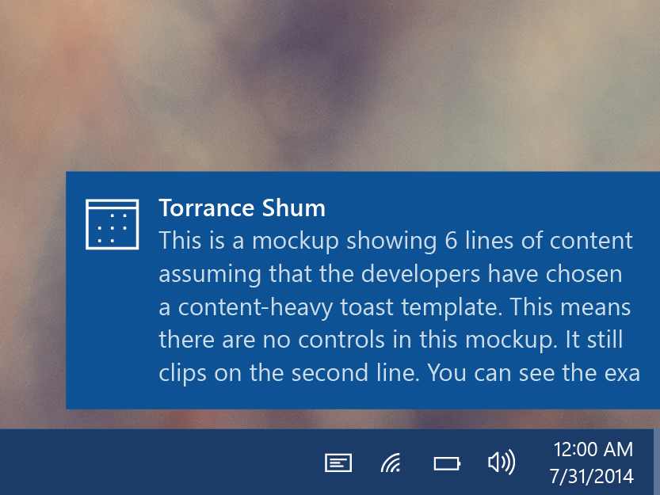
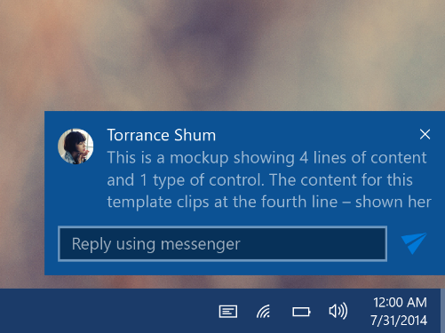
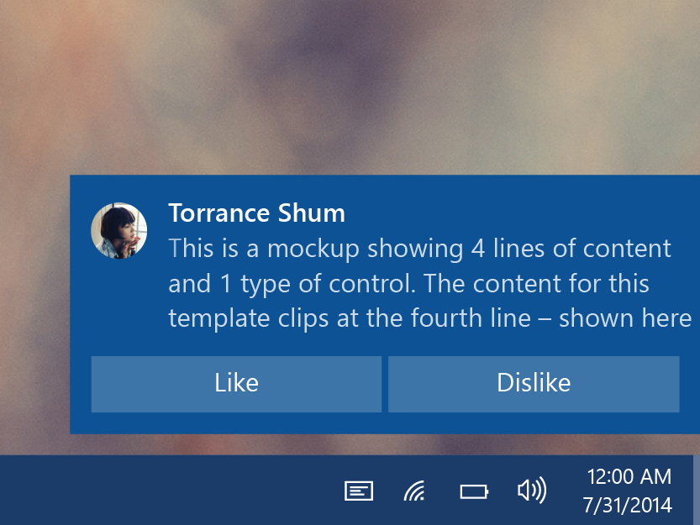
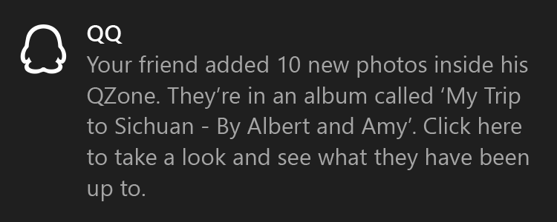
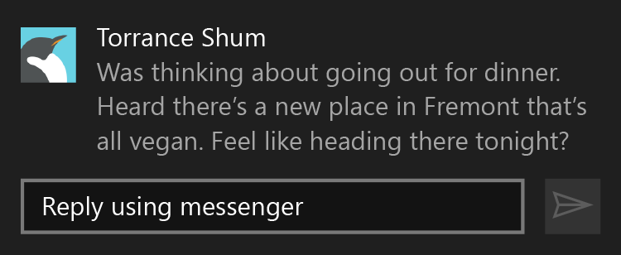
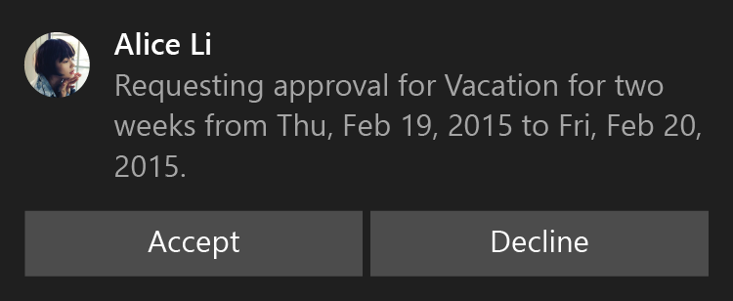
Toast notifications in Windows 10
Flexible layouts (images, multiple lines of text, etc.)
Support for interactive elements
When the user interacts with the notification, it can trigger a background task
Notes:
Min time depends on the resources on the system; bigger systems get more time: sometimes even never suspended
2 extended execution:
At Suspending event time → I need more time than the 5s
At foreground time → I need to ALWAYS run (I won’t get the Suspending event but just the Revoked first and then the Suspending just before being terminated)

Slide 50
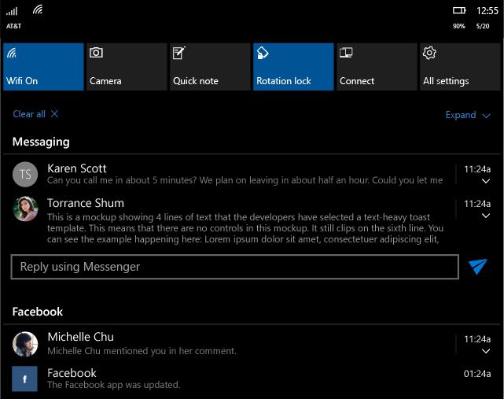
Toast notifications in Windows 10
<toast>
<visual>
<binding template=“ToastGeneric”>
<text>Torrance Shum</text>
<text>This is…</text>
<image placement=“appLogoOverride” src=“Torrance.png” />
</binding>
</visual>
<actions>
<input id=“1" type=“text“ />
<action activationType=“background" arguments=“quickReply"
hint-inputId=“1" content="" imageUri=“send.png” />
</actions>
</toast>
The notification is described by a XML payload
Optionally, you can use the Notifications Extensions library
Notes:
Min time depends on the resources on the system; bigger systems get more time: sometimes even never suspended
2 extended execution:
At Suspending event time → I need more time than the 5s
At foreground time → I need to ALWAYS run (I won’t get the Suspending event but just the Revoked first and then the Suspending just before being terminated)

Slide 51
Demo Toasts

Slide 52
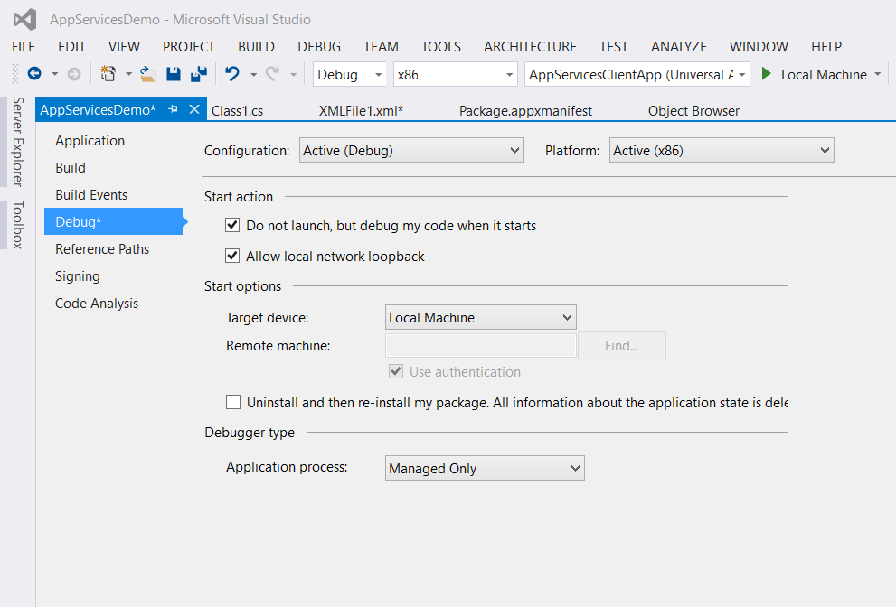
Debugging App Services
Set breakpoints in app service code
Check ‘Do not launch but debug my code when it starts’ in project properties
Launch app service foreground app in debugger – nothing happens!
Run client app to connect to app service
Debugger attaches and breaks on your breakpoint
Notes:
TODO: check in VS 2015 RTM

Slide 53
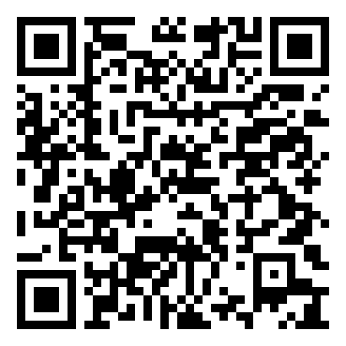
http://aka.ms/DOTNETT4S2

Slide 54
Matteo Pagani
Windows AppConsult Engineer @ Microsoft
matteo.pagani@microsoft.com
Twitter: @qmatteoq
http://aka.ms/DOTNETT4S2

